Slide 1

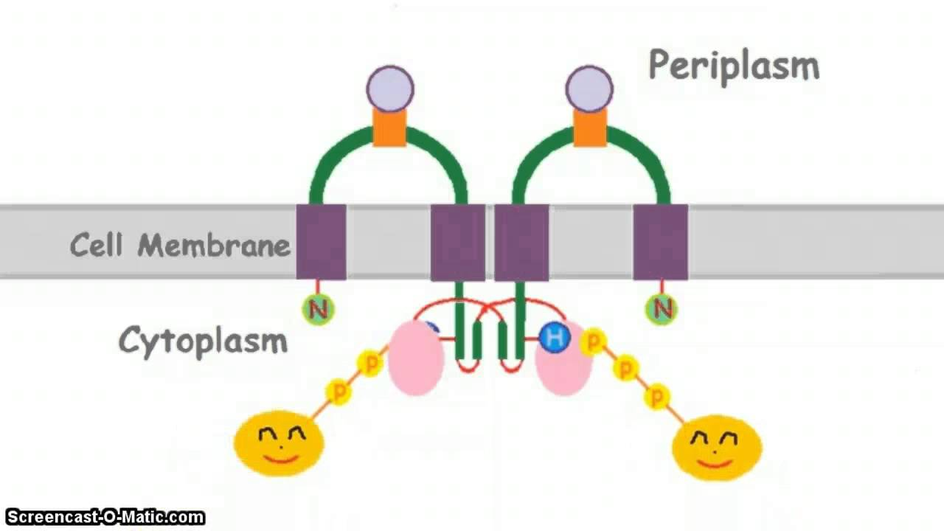
Hysteric and Graded responses in bacterial two-component signal transduction
Project Presentation for CL663 Systems Biology
By
-Rajesh Kannan (164026009)
-Akshay Bhamare (160020023)

Slide 2
Outline
1. Motivation
2. Objectives
3. Methods
4. Results
5. Conclusions
6. References

Slide 3
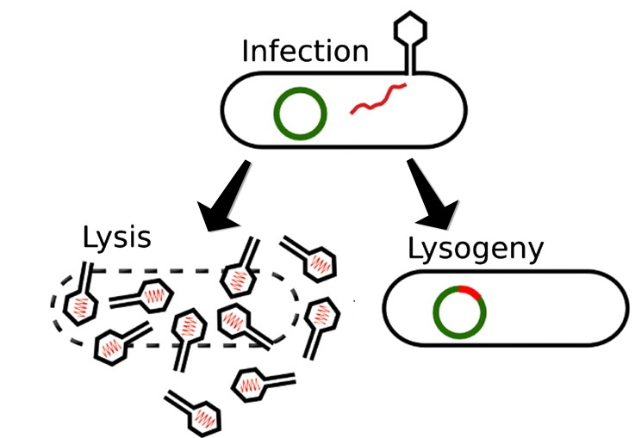
Motivation
Occurrence of bistability in the biological system
Binary decision making
Lac operon system
Bacteriophage decides lytic and lysogenic cell cycle
Positive feedback loop in the transcription networks showed a bistable response
Bistability in transduction signalling network
http://www.virology.ws/2017/01/26/communication-between-virus-infected-cells/
Bacteriophage decides lytic and lysogenic cell cycle

Slide 4
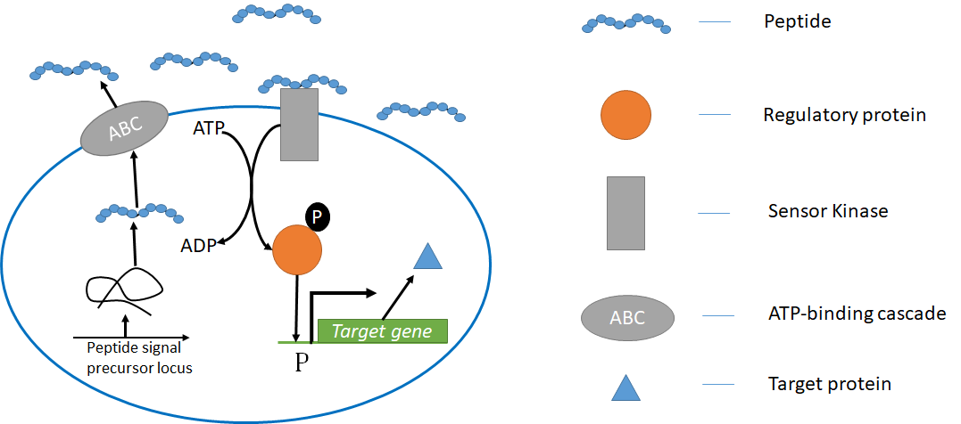
Objectives
To study TCS in EnvZ/OmpR system
Observe the dynamic response of various TCS network arrangement.
To discuss the physiological consequences of bistability.
Schematic of TCS in Gram positive bacteria

Slide 5
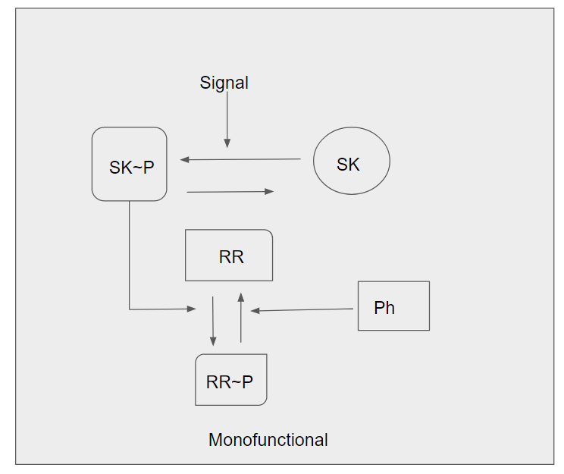
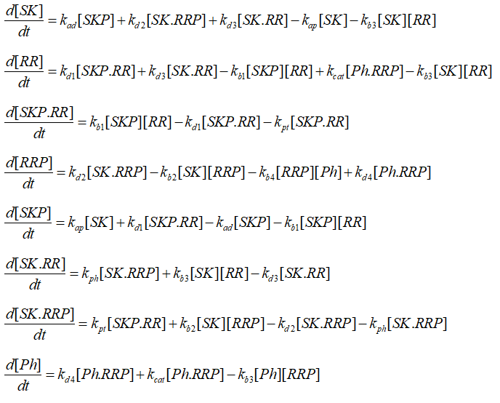
Methodology
Signalling cascade of classic monofunctional TCS `
TCS with monofunctional network where the signal kinase (SK) sense the signal from the environment and triggers the series of phosphorylation events.

Slide 6
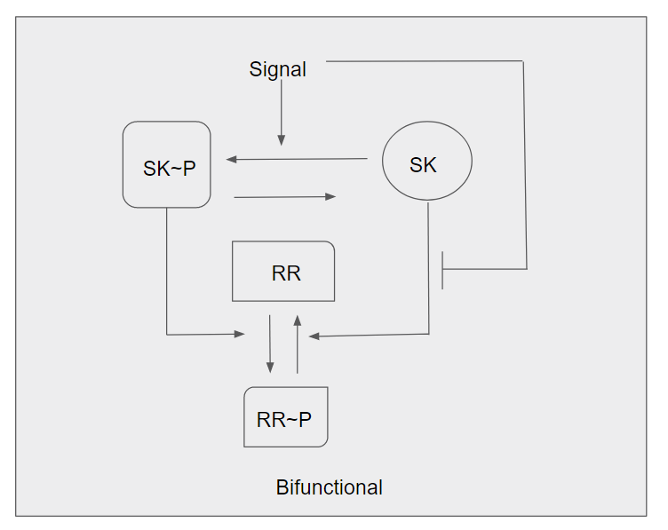
Methodology
1
Schematic of bifunctional TCS network where the SK triggers the series of phosphorylation events and also dephosphorylate the response regulator (RR).

Slide 7
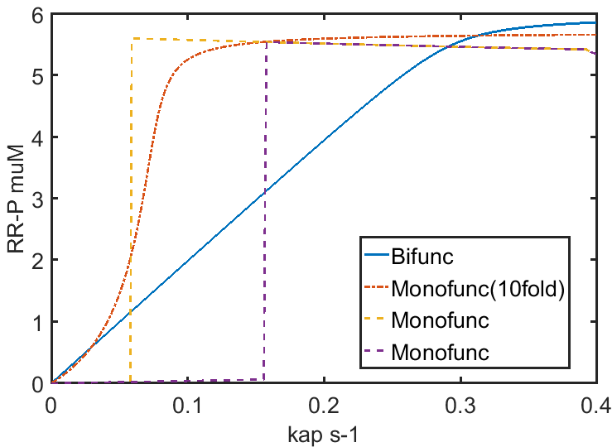
Steady state response in Bifunctional and Mono-functional TCS
Output function curve with signal parameter, kap.
Concentration of RR~P affects the gene expression of various other protein such as OmpC, OmpF etc.
Concentration of [RR~P] as the function of kap, rate constant parameter of phosphorylation od SK.

Slide 8
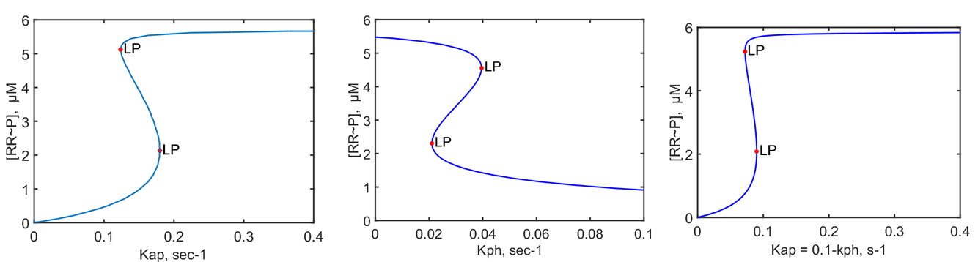
Bistability
Bistable response for both the TCS circuit
Alternative phosphatase alter graded response to hysteric in bifunctional TCS
1
Concentration profile of RR~P for A) monofunctional TCS , B) Phosphatase rate of the bifunctional TCS, C) Linear function b/w both rates

Slide 9
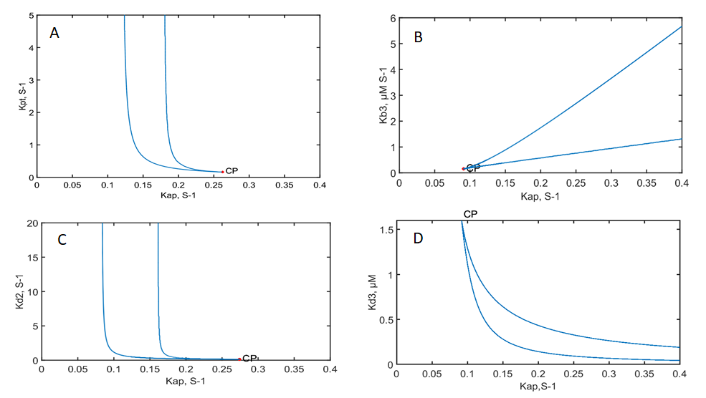
Range of Parameter values that supports bistability
Robustness of bistability against the parameter values
Bistability shown by taking different parameter against the auto phosphorylation rate constant, Kap.
1
Parametric space shows bistability region for monofunctional TCS.

Slide 10
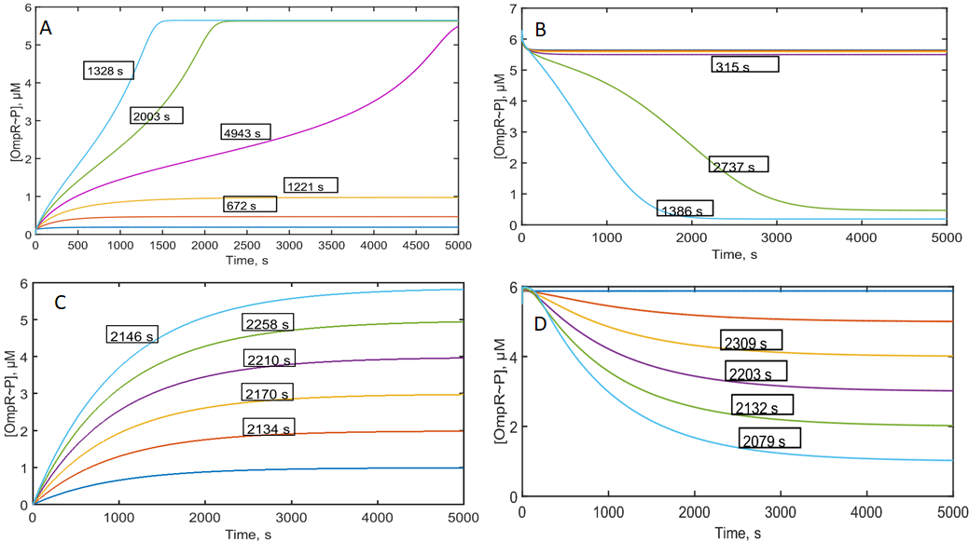
Dynamic response of Bifunctional and Monofunctional TCS
The dynamic response of two TCS has been studied to estimate the response time of the circuit.
For various values of Kap, the time response can be inferred
1
Dynamic response of monofunctional and bifunctional TCS for different kap values.

Slide 11
Discussion
From the results, presence of alternative phosphatase could leads bistability.
From the structural analysis of EnvZ/OmpR TCS, there is a possibility of formation of dead-end complex between EmpvZ-OmpR.
These two results can lead to the possible explanation for the occurrence of bistability in the TCS.
In Monofunctional, dead-end complex prevents RR~P formation and has [positive feedback effect.
In the case of bifunctional TCS, the formation of dead-end complex forms a negative feedback.

Slide 12
Discussion
If no alternative Ph is present, positive and negative feedback counteract each other and nullify.
If there is a large amount of dephosphorylation of RR~P occurs without depending on SK, then we can expect bistability to occur.
The dynamic responses shows the response time for the switch between ON and OFF while the rate of phosphorylation of SK changes.

Slide 13
References
Oleg A Igoshin, Rui Alves, Michael A Savageau, Hysteretic and graded responses in bacterial two-component signal transduction. Molecular Microbiology (2008) 68(5), 1196–1215

